Slide 1
Point Processing
S.k. vipparthi

Slide 2
Point Processing
Spatial Operation
Gray-Level Mapping
Non-linear Gray-Level Mapping
Gamma Mapping
Logarithmic Mapping
Exponential Mapping
The Image Histogram
Histogram Stretching
Histogram Equalization
Thresholding
Color Thresholding

Slide 3
Spatial Operation
Single Pixel Operation
Neighborhood Operation
Geometric Spatial Transformation
A Spatial Transform of Coordinates
Intensity Interpolation
Geometric Spatial Transformation
Affine Transform
Forward Mapping
Inverse Mapping

Slide 4
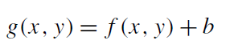
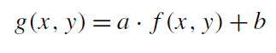
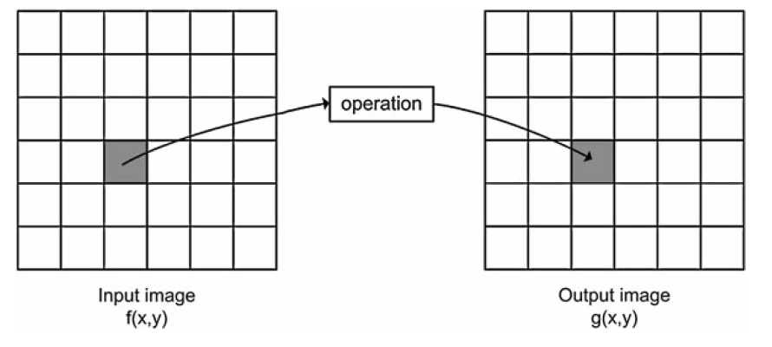
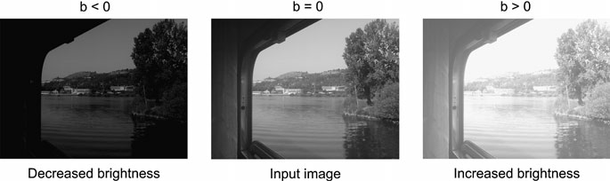
Gray-Level Mapping
Fig. The principle of point processing.

Slide 5
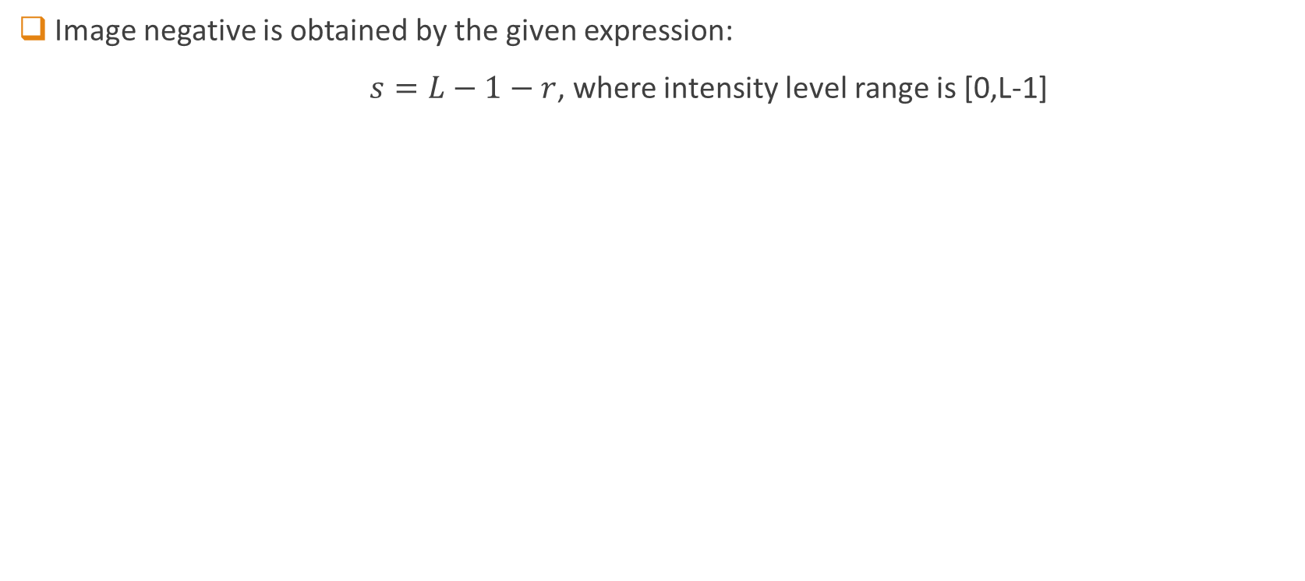
Negative Transformation
Image negative is obtained by the given expression:
$s=L−1−r$, where intensity level range is [0,L-1]
L-1
Output Intensity Level s
0
Input Intensity Level r
L-1

Slide 6
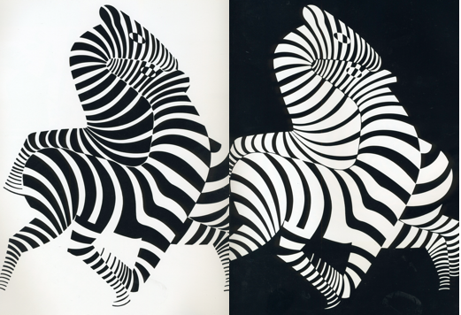

Slide 7
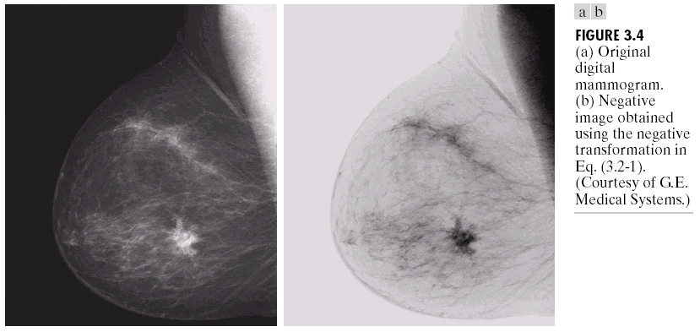

Slide 8
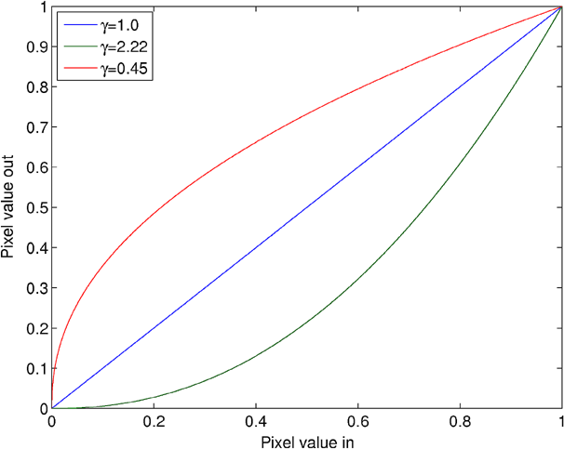
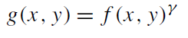
Non-linear Gray-Level Mapping
Power Law (Gamma Mapping) Transformation

Slide 9
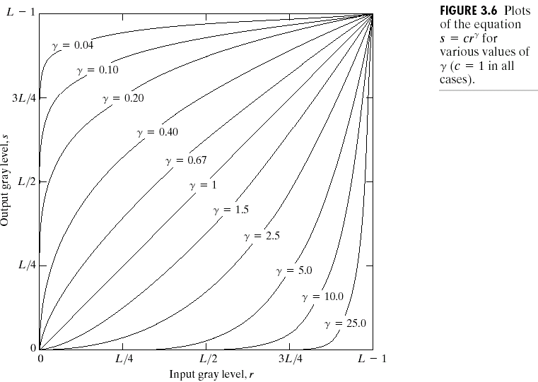

Slide 10
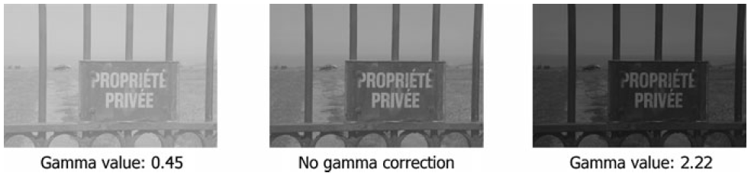

Slide 11
Gamma(Power-Law) Transformation

Slide 12
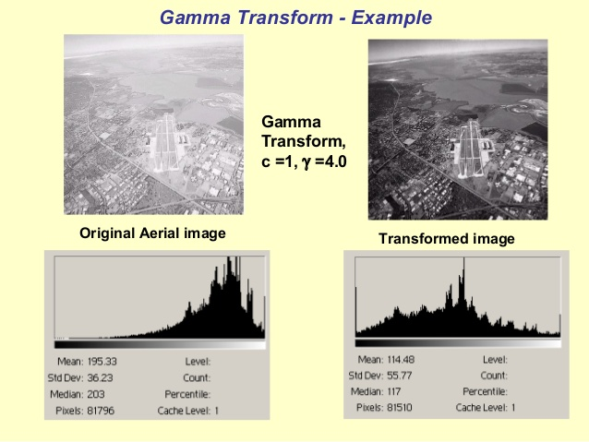

Slide 13
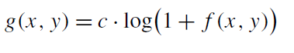
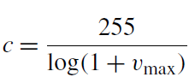
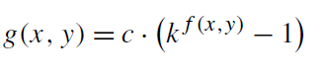
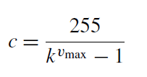
Logarithmic Mapping
Exponential Mapping

Slide 14
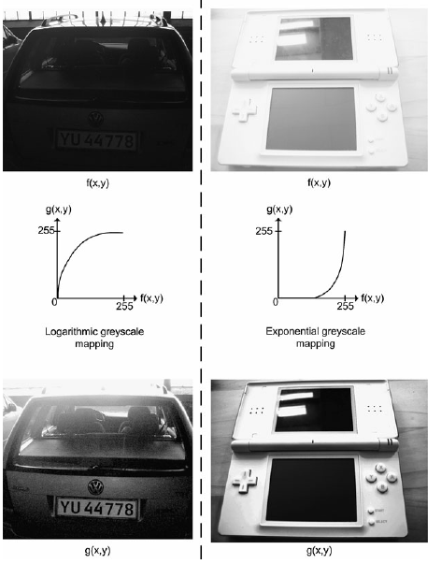
Fig.: Examples of logarithmic and exponential gray-level mappings. Logarithmic mapping is useful for bringing out details in dark images and exponential mapping is useful for bringing out details in bright images.

Slide 15
Piecewise-Linear Transformation Functions
Intensity Level Slicing
Contrast Stretching / Histogram stretching
Bit-plane slicing

Slide 16
Intensity-level Slicing
Highlighting a specific range of intensities of an image.
There are two main different approaches:
Highlight a range of intensities while diminishing all others to a constant low level.
Highlight a range of intensities but preserve all others.

Slide 17
Intensity-level Slicing

Slide 18
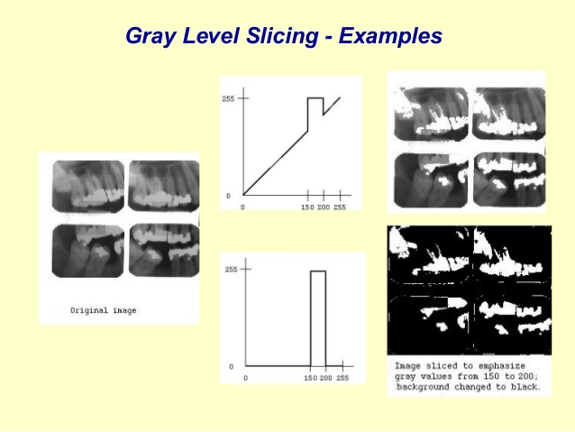
Background changed to black

Slide 19
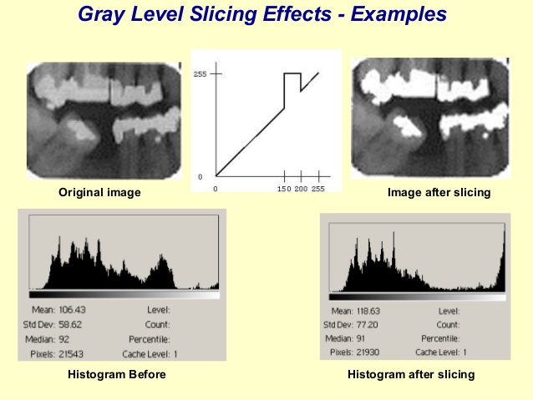
Background kept as it is

Slide 20
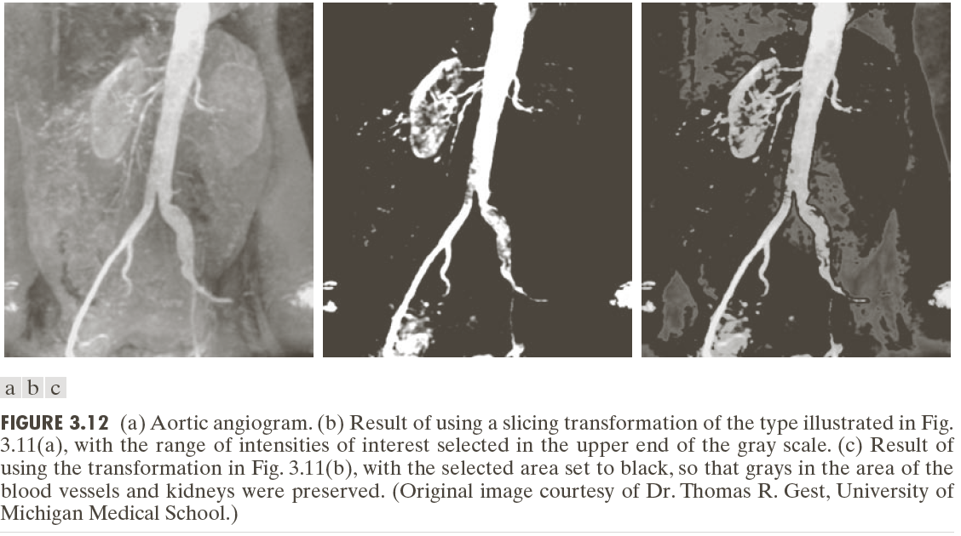

Slide 21
Bit-Plane Slicing
Highlighting the contribution made to total image appearance by specific bits.
Suppose that each pixel in an image is represented by 8 bits. Imagine the image is composed of 8, 1-bit planes ranging from bit plane 0 (LSB) to bit plane 7 (MSB).

Slide 22
What is the importance of it?
Separating a digital image into its bit planes is useful for analysing the relative importance played by each bit of the image.
It determines the adequacy of numbers of bits used to quantize each pixel , useful for image compression.

Slide 23
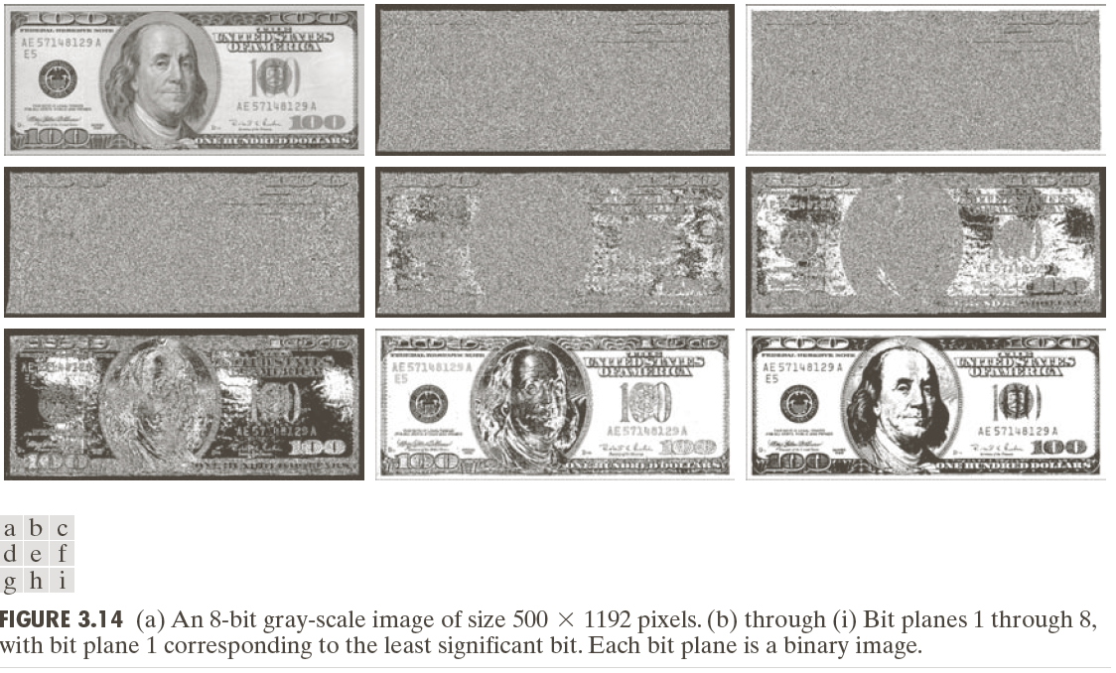

Slide 24
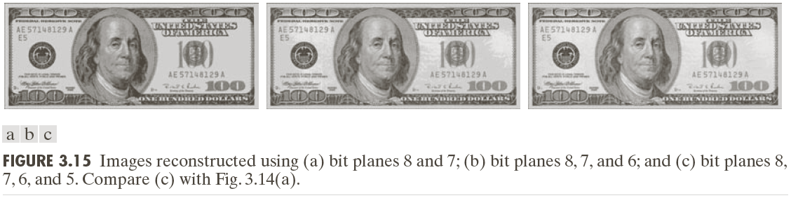

Slide 25
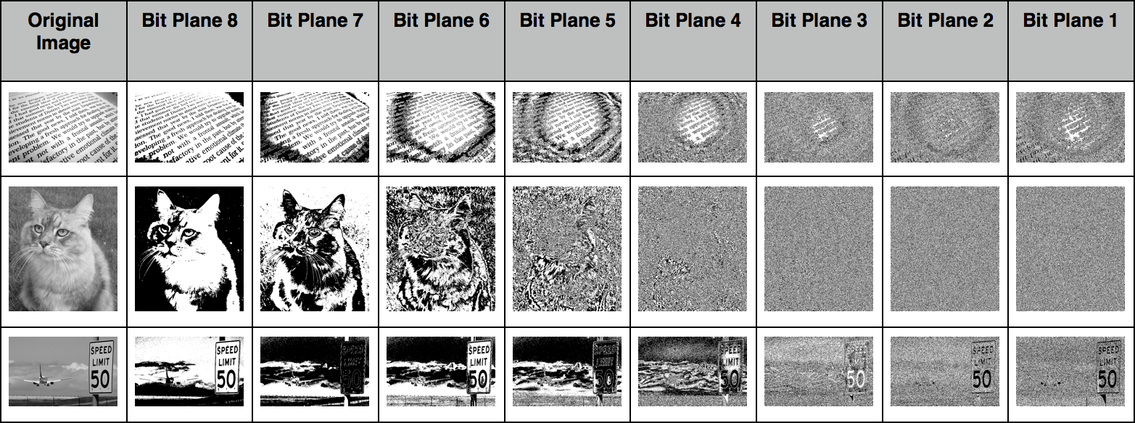

Slide 26
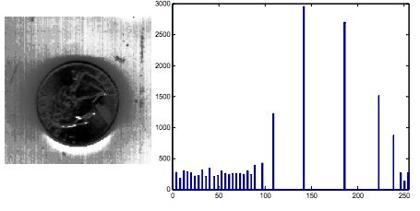
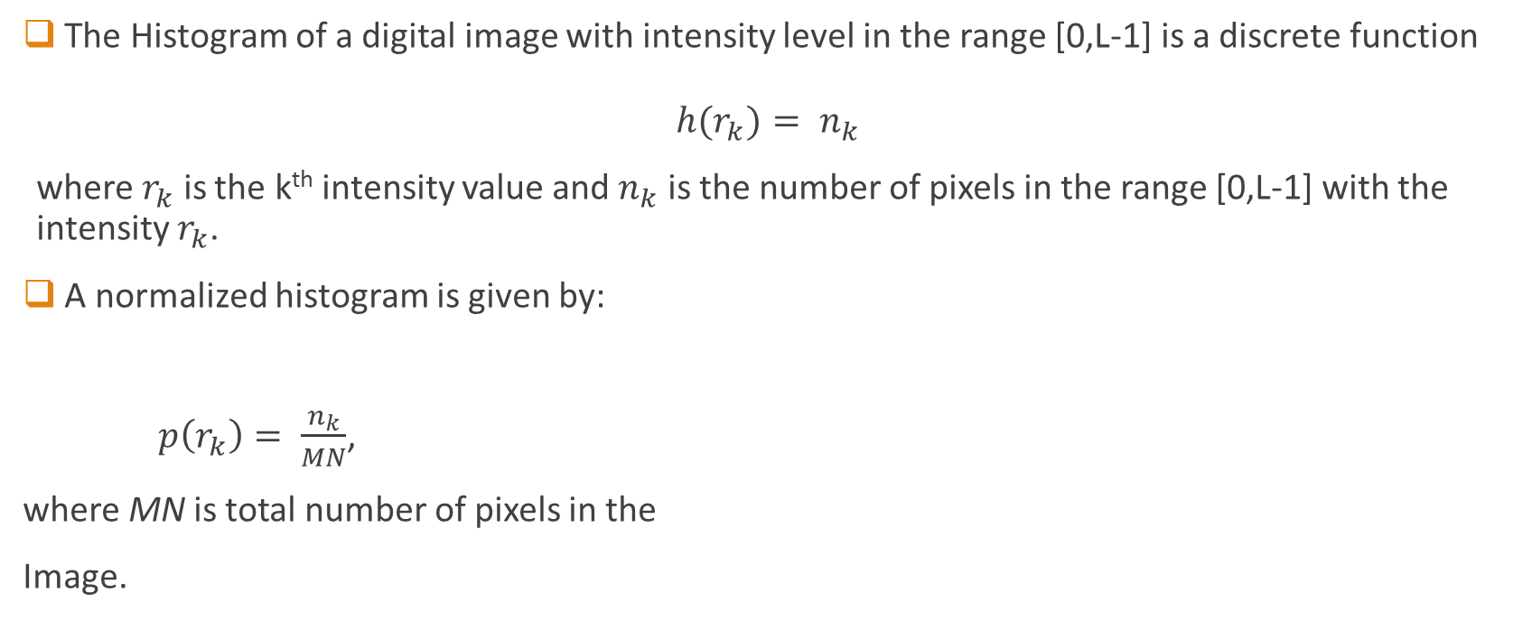
Histogram Processing
The Histogram of a digital image with intensity level in the range [0,L-1] is a discrete function
$${h(r}_{k})= n_{k}$$
where $r_{k}$ is the k^{th} intensity value and $n_{k}$ is the number of pixels in the range [0,L-1] with the intensity $r_{k}$.
A normalized histogram is given by:
$p\left(r_{k}\right)= \frac{n_{k}}{MN}$,
where MN is total number of pixels in the
Image.

Slide 27
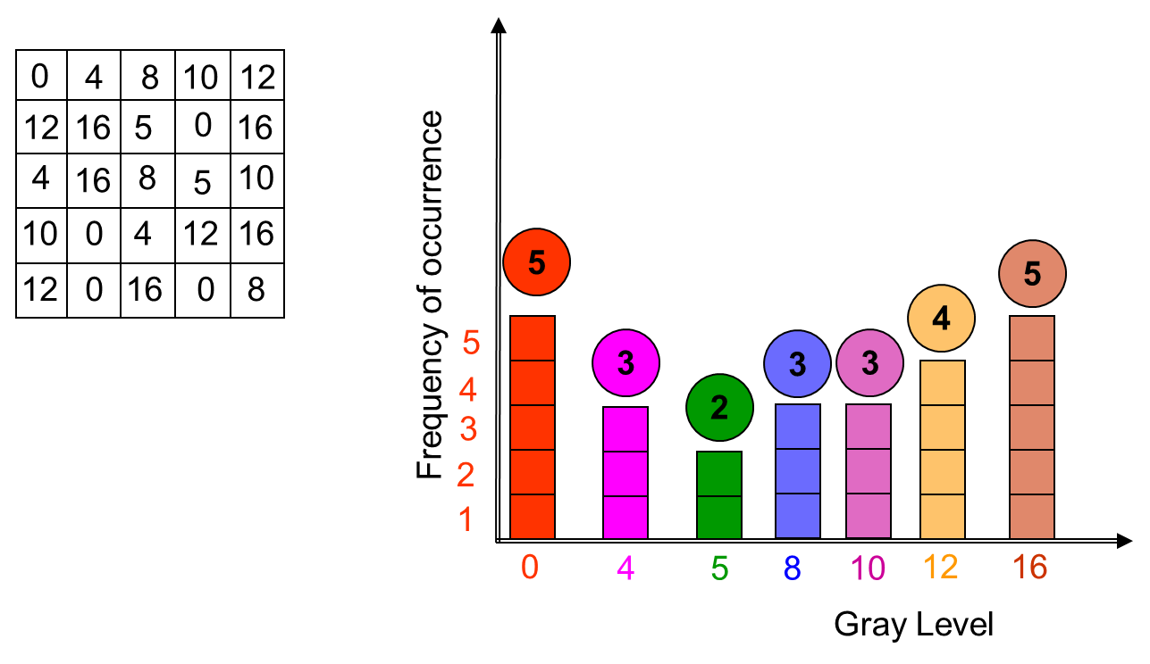

Slide 28
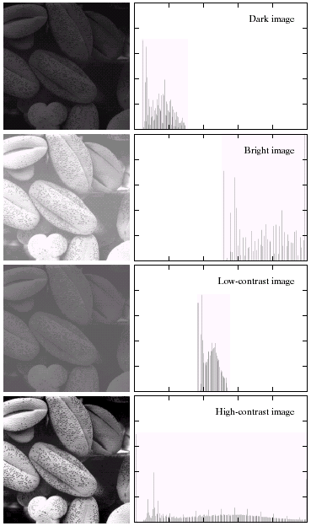
Histogram Processing

Slide 29
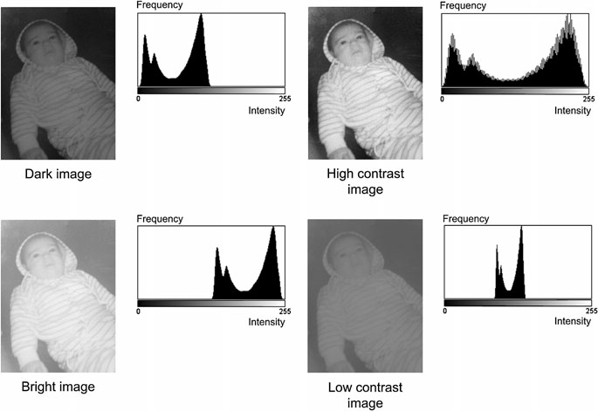

Slide 30
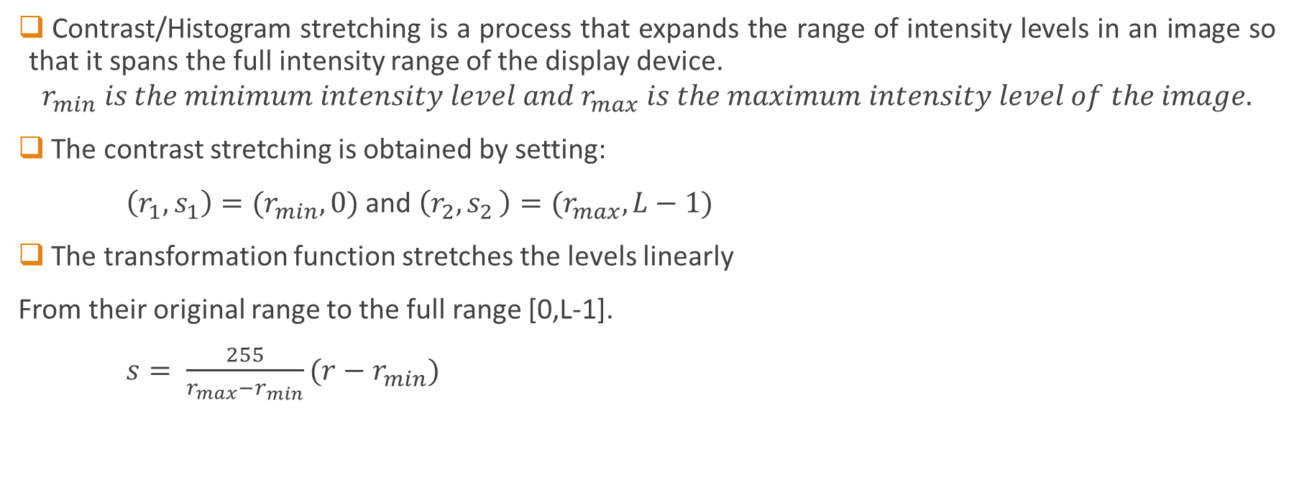
Contrast Stretching
Contrast/Histogram stretching is a process that expands the range of intensity levels in an image so that it spans the full intensity range of the display device.
$$r_{min} is the minimum intensity level and{ r}_{max} is the maximum intensity level of the image.$$
The contrast stretching is obtained by setting:
$\left(r_{1},s_{1}\right)=(r_{min},0)$ and $\left(r_{2}{,s}_{2}\right)=(r_{max},L−1)$
The transformation function stretches the levels linearly
From their original range to the full range [0,L-1].
$s= \frac{255}{r_{max}−r_{min}}(r−r_{min})$

Slide 31
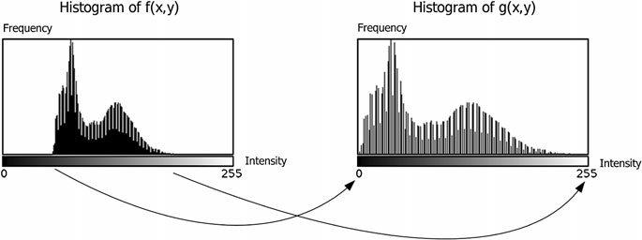
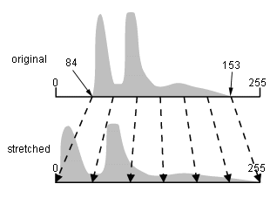
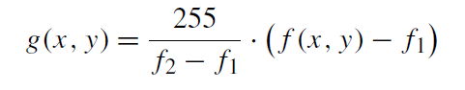
Histogram Stretching
Fig. The concept of histogram stretching

Slide 32
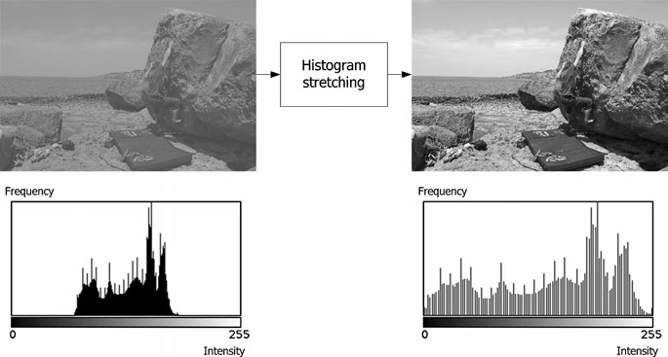
Fig. An example of histogram stretching

Slide 33
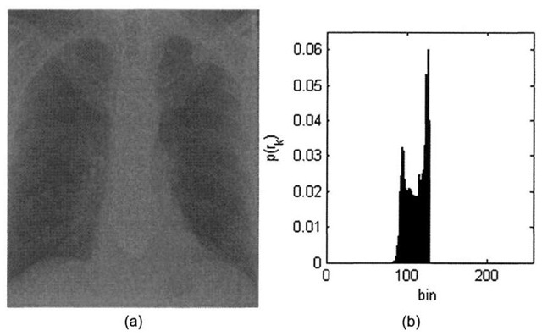
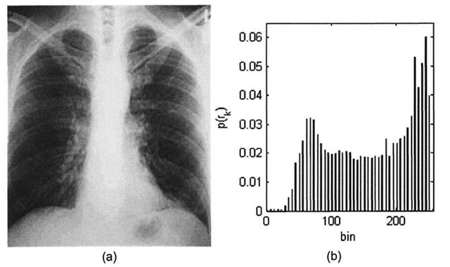
Fig. An example of histogram stretching

Slide 34
If just one pixel has the value 0 and another 255, histogram stretching will not work, since f2 −f1 = 255.
A solution is modified histogram stretching where small bins in the histogram are removed by changing their values to those of larger bins.
But if a significant number of pixels with very small and very high values exit, we still have f2−f1 = 255, and hence the histogram (and image) remains the same.
A more robust method to improve the histogram (and image) is therefore to apply histogram equalization.

Slide 35
Histogram Equalization
Τhe histogram equalization is an approach to enhance a given image.
The approach is to design a transformation T(.) such that the gray values in the output is uniformly distributed in [0, 1].
This usually results in an enhanced image, with an increase in the dynamic range of pixel values.

Slide 38
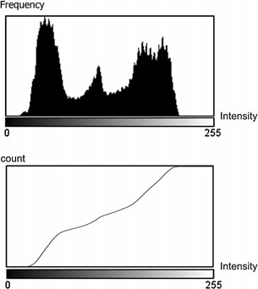
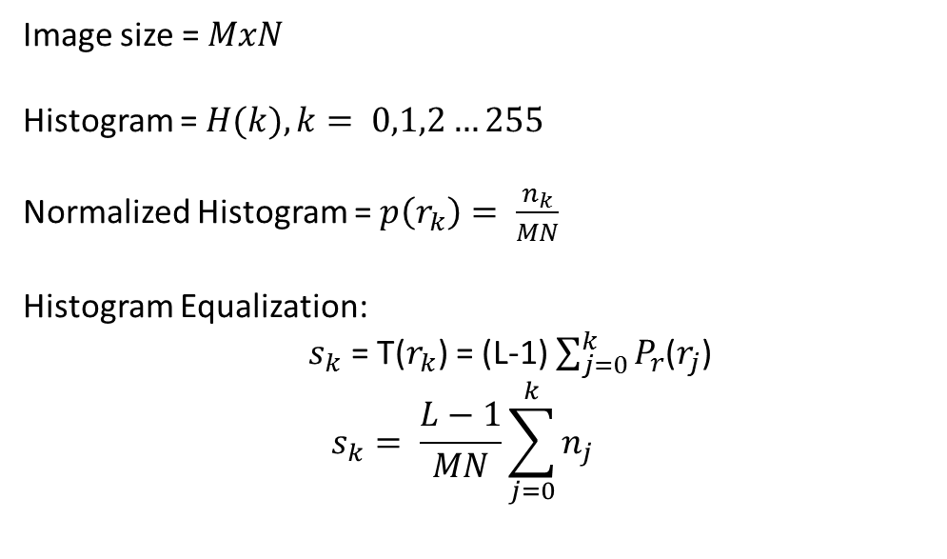
Image size = $MxN$
Histogram = $H(k), k= 0,1,2…255$
Normalized Histogram = $p\left(r_{k}\right)= \frac{n_{k}}{MN}$
Histogram Equalization:
$s_{k}$ = T($r_{k}$) = (L-1) $\sum_{j=0}^{k}{P_{r}}$($r_{j}$)
$$s_{k}= \frac{L−1}{MN}\sum_{j=0}^{k}{n_{j}}$$

Slide 39
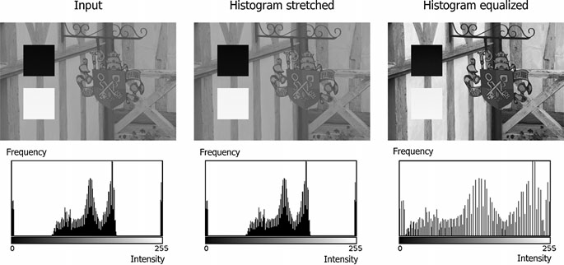
Fig. The effect of histogram stretching and histogram equalization on an input image with both very high and very low pixel values

Slide 40
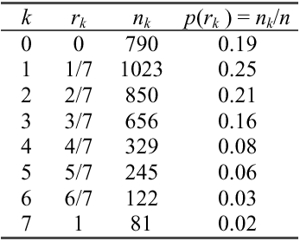
Example:
• Consider an 8-level 64 x 64 image with gray values (0, 1, …,7). The normalized gray values are (0, 1/7, 2/7, …, 1). The normalized histogram is given below:

Slide 41
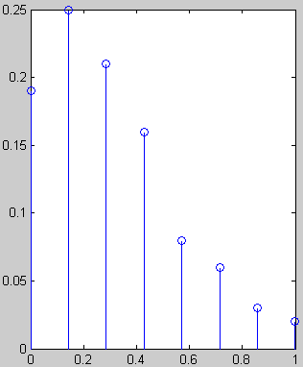
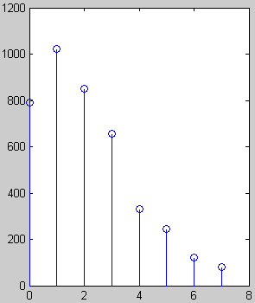
Fraction of # pixels
# pixels
Gray value
Normalized gray value

Slide 42
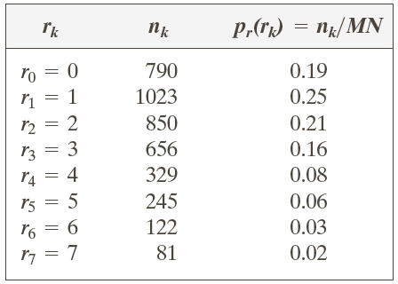
Example: Histogram Equalization

Slide 43
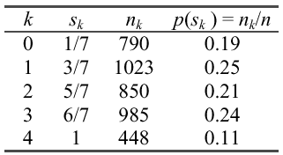
• Notice that there are only five distinct gray levels -- (1, 3,5,6,7) in the output image. We will relabel them as (s₀,s₁, …, s₄ ).
• With this transformation, the output image will have histogram

Slide 44
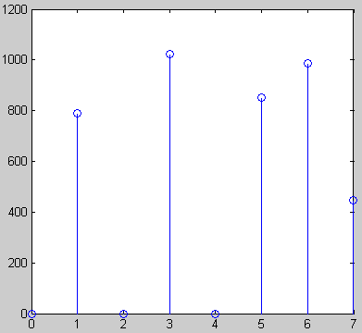
Histogram of output image
# pixels
# pixels
Gray values
Gray value
• Note that the histogram of output image is only approximate, and not exactly, uniform.

Slide 46
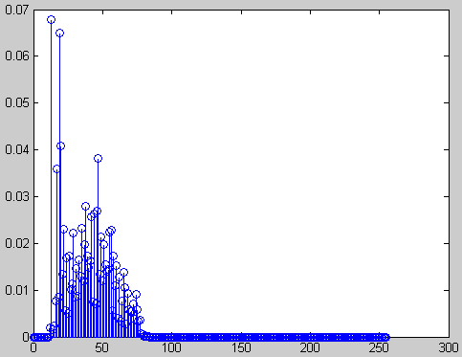
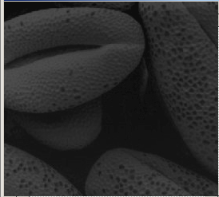
Original image and its Histogram

Slide 47
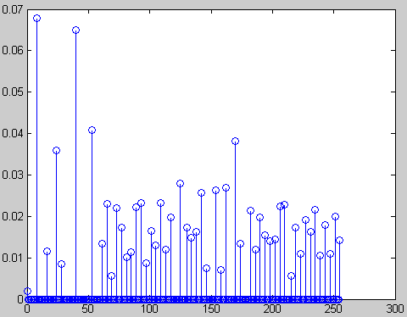
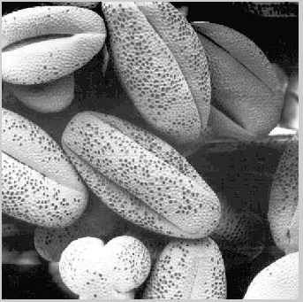
Histogram equalized image and its Histogram

Slide 48
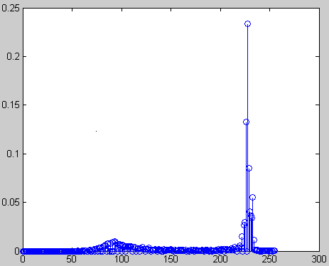
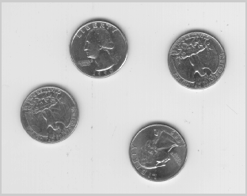
Comments:
Histogram equalization may not always produce desirable results, particularly if the given histogram is very narrow.
It can produce false edges and regions. It can also increase image “graininess” and “patchiness.”

Slide 49



Slide 51
Histogram Specification
Histogram equalization yields an image whose pixels are (in theory) uniformly distributed among all gray levels.
Sometimes, this may not be desirable. Instead, we may want a transformation that yields an output image with a pre-specified histogram. This technique is called histogram specification.
In other words Transforming the intensity values so that the histogram of the output image aapproximately matches a specified histogram.

Slide 52
Given Information:
(1) Input image from which we can compute its histogram .
(2) Desired histogram.
Goal:
Derive a point operation, H(r), that maps the input image into an output image that has the user-specified histogram.

Slide 53
Histogram Specification: Procedure
Equalize the levels of the original image.
Specify the desired density function (histogram) and obtain the transformation function G(z).
Apply the inverse transformation function z = G(s) to the levels obtained in first step.

Slide 54

Histogram Specification: Procedure
Obtain p_{r}(r_{j}) from the input image and then obtain the values of s_{k}, round the value to the integer range [0, L-1].
Use the specified PDF and obtain the transformation function G(z_{q}), round the value to the integer range [0, L-1].
Where $p_{z}\left(z\right)$ is the specified PDF.

Slide 55
Histogram Specification: Procedure
Mapping from s_{k} to z_{q}
• If the transformation z_{k} → G(z_{k}) is one-to-one, the inverse transformation s_{k} → G⁻¹ (s_{k}) , can be easily determined, since we are dealing with a small set of discrete gray values.
• In practice, this is not usually the case (i.e. z_{k} → G(z_{k}) is not one-to-one) and we assign gray values to match the given histogram, as closely as possible.

Slide 56
desired
0.3
0.3
0.2
0.2
0.1
0.1
0
1
2
3
4
5
6
7
0
1
2
3
4
5
6
7
0 – 0.19
1 – 0.25
2 – 0.21
3 – 0.16
4 – 0.08
5 – 0.06
6 – 0.03
7 – 0.02
0 – 0.0
1 – 0.0
2 – 0.0
3 – 0.15
4 – 0.20
5 – 0.30
6 – 0.20
7 – 0.15
1.0
1.0
0.8
0.8
0.6
0.6
0.4
0.4
0.2
0.2
0.0
0.0
0
1
2
3
4
5
6
7
0
1
2
3
4
5
6
7

Slide 57
equalized histogram
0.3
0.3
0.2
0.2
0.1
0.1
r
s
0
1
0
1
2
3
4
5
6
7
7
1.0
6
0.8
5
4
0.6
3
0.4
2
0.2
1
0
0.0
0
1
2
3
4
5
6
7

Slide 58
equalized histogram
0.3
0.3
0.3
0.2
0.2
0.2
0.1
0.1
0.1
r
s
0
1
0
1
2
3
4
5
6
7
1
3
7
1.0
6
0.8
5
4
0.6
3
0.4
2
0.2
1
0
0.0
0
1
2
3
4
5
6
7

Slide 59
equalized histogram
0.3
0.3
0.3
0.2
0.2
0.2
0.1
0.1
0.1
r
s
0
1
0
1
2
3
4
5
6
7
1
3
2
5
7
1.0
6
0.8
5
4
0.6
3
0.4
2
0.2
1
0
0.0
0
1
2
3
4
5
6
7

Slide 60
equalized histogram
0.3
0.3
0.3
0.2
0.2
0.2
0.1
0.1
0.1
r
s
0
1
0
1
2
3
4
5
6
7
1
3
2
5
7
1.0
6
0.8
3
6
5
4
0.6
3
0.4
2
0.2
1
0
0.0
0
1
2
3
4
5
6
7

Slide 61
equalized histogram
0.3
0.3
0.3
0.2
0.2
0.2
0.1
0.1
0.1
r
s
0
1
0
1
2
3
4
5
6
7
1
3
2
5
7
1.0
6
0.8
3
6
5
4
0.6
4
6
3
0.4
2
0.2
1
0
0.0
0
1
2
3
4
5
6
7

Slide 62
equalized histogram
0.3
0.3
0.3
0.2
0.2
0.2
0.1
0.1
0.1
r
s
0
1
0
1
2
3
4
5
6
7
1
3
2
5
7
1.0
6
0.8
3
6
5
4
0.6
4
6
3
0.4
5
2
7
0.2
1
0
0.0
0
1
2
3
4
5
6
7

Slide 63
equalized histogram
0.3
0.3
0.3
0.2
0.2
0.2
0.1
0.1
0.1
r
s
0
1
0
1
2
3
4
5
6
7
1
3
2
5
7
1.0
6
0.8
3
6
5
4
0.6
4
6
3
0.4
5
2
7
0.2
1
6
7
0
0.0
0
1
2
3
4
5
6
7

Slide 64
equalized histogram
0.3
0.3
0.3
0.2
0.2
0.2
0.1
0.1
0.1
r
s
0
1
0
1
2
3
4
5
6
7
1
3
0
1
2
3
4
5
6
7
2
5
7
1.0
6
0.8
3
6
5
4
0.6
4
6
3
0.4
5
2
7
0.2
1
6
7
0
0.0
7
7
0
1
2
3
4
5
6
7

Slide 65
equalized histogram
0.3
0.3
0.3
0.2
0.2
0.2
0.1
0.1
0.1
r
s
0
1
0
1
2
3
4
5
6
7
1
3
0
1
2
3
4
5
6
7
2
5
1 = 0.19
3 = 0.25
5 = 0.21
6 = .16+.08=.24
7 = .06+.03+.02
= 0.11
7
1.0
6
0.8
3
6
5
4
0.6
4
6
3
0.4
5
2
7
0.2
1
6
7
0
0.0
7
7
0
1
2
3
4
5
6
7

Slide 66
desired
equalized histogram
0.3
0.3
0.2
0.2
0.1
0.1
r
s
0
0
1
0
0
1
2
3
4
5
6
7
0
1
2
3
4
5
6
7
2
0
7
1.0
3
1
6
0.8
5
4
2
4
0.6
3
0.4
5
4
2
0.2
6
6
1
0
0.0
7
7
0
1
2
3
4
5
6
7

Slide 67
0
1
3
equalized orig
resultant histogram
1
3
0.3
0.3
4
2
5
0.2
5
0.2
3
6
6
0.1
0.1
4
6
6
5
7
7
6
7
7
0
1
2
3
4
5
6
7
0
1
4
6
7
2
3
5
7
7
7
7
1.0
0.3
6
0.8
5
0.2
4
0.6
3
0.4
0.1
2
0.2
1
0
0.0
desired
0
1
4
6
7
0
1
2
3
4
5
6
7
2
3
5

Slide 68

Example: Histogram Matching
Suppose that a 3-bit image (L=8) of size 64 × 64 pixels (MN = 4096) has the intensity distribution shown in the following table (on the left). Get the histogram transformation function and make the output image with the specified histogram, listed in the table on the right.

Slide 69
Example: Histogram Matching
Obtain the scaled histogram-equalized values,
Compute all the values of the transformation function G,
s₀
s₁
s₂
s₃
s₄
s₅
s₆
s₇

Slide 70
Example: Histogram Matching

Slide 71
Example: Histogram Matching

Slide 72
Example: Histogram Matching

Slide 73
Example: Histogram Matching

Slide 74

Example: Histogram Matching

Slide 75


Slide 76
Local Histogram Processing
Sometimes only a part of an image may require enhancement. In that case we can perform local histogram processing.
Define a neighborhood and move its center from pixel to pixel.
At each location, the histogram of the points in the neighborhood is computed. Either histogram equalization or histogram specification transformation function is obtained.
Map the intensity of the pixel centered in the neighborhood. Move to the next location and repeat the procedure.

Slide 78

Spatial Filtering
A spatial filter consists of (a) a neighborhood, and (b) a predefined operation.
Median Filter
Mean Filter
Correlation/Convolution
Template Matching
Edge Detection
Gradients
Image Edges
Image Sharpening

Slide 79


Slide 80

Correlation
Difference between Correlation and Convolution

Slide 81

Convolution
Difference between Correlation and Convolution
$$g\left(x,y\right)=\sum_{j=−R}^{R}{\sum_{j=−R}^{R}{h\left(i,j\right).f\left(x−i,y−j\right)}}$$

Slide 83



Slide 84

Fig. Convolution Layer

Slide 85
Difference between Convolution and Correlation
Convolution is a similar operation, with just one subtle difference:
Correlation
a
b
c
r
s
t
*
e_{processed} = v*e + z*h + y*g + x*f +w*e + u*d + t*c + s*b + r*a
d
e
e
u
v
w
f
g
h
x
y
z
Original Image Pixels
Filter
Convolution
e_{processed} = v*e + z*a + y*b + x*c +w*d + u*e + t*f + s*g + r*h
For symmetric filters it makes no difference

Slide 86
Convolution and Correlation
filtering and edge detection
the output gray-level at a pixel is a weighted sum of the gray-levels of pixels in the neighborhood
kernel elements are taken left-to-right, top-to-bottom
image elements (in the neighborhood) are taken right-to-left, bottom-to-top
feature recognition
the kernel is now called a template
algorithm is the same as convolution except for the pairing of weights with pixels:
kernel elements are taken left-to-right, top-to-bottom
image elements (in the neighborhood) are taken left-to-right, top-to-bottom
you can get correlation using the convolution algorithm by rotating the kernel 180°
the disadvantage of being sensitive to changes in the amplitude
need to normalize the output

Slide 87
Applications
h_h{1,1}=[-1,1,0];
h_h{1,2}=[0,0,0;0,1,0;-1,0,0];
h_h{1,3}=[0;1;-1];
h_h{1,4}=[0,0,0;0,1,0;0,0,-1];
h_h{1,5}=[0,1,-1];
h_h{1,6}=[0,0,-1,;0,1,0;0,0,0];
h_h{1,7}=[-1;1;0];
h_h{1,8}=[-1,0,0;0,1,0;0,0,0];

Slide 88



Slide 89
Mean Filter
Also called Smoothing spatial filters and used for blurring and for noise reduction.
Blurring is used in removal of small details and bridging of small gaps in lines or curves

Slide 90

The Median Filter
Application: Image Denoising

Slide 91




Slide 93


Slide 94


Mean Filter
3 x 3 Smoothing filter
Original Image
Smoothened Image

Slide 95

Mean Filter
5 x 5 Smoothing filter
Original Image
Smoothened Image

Slide 96



Average Vs Weighted Average
Original Image

Slide 97

Fig. An example of how a mean filter can be used to hide the identity of a person.

Slide 98

Image Smoothing Example
The image at the top left is an original image of size 500*500 pixels
The subsequent images show the image after filtering with an averaging filter of increasing sizes
3, 5, 9, 15 and 35
Notice how detail begins to disappear

Slide 99



Edge Detection
Image Edges: Gradients
Fig. Prewitt and Sobel kernels

Slide 100

Fig. Sobel kernels applied to an image.

Slide 101
Image Sharpening
Highlight transition in intensity
The principal objective of sharpening is to highlight fine detail in an image or to enhance detail that has been blurred.
Electronic printing
Medical Imaging
Industrial Inspection
Autonomous guidance in military systems

Slide 102
Averaging is analogous to integration
Image
Blurred Image
Sharpening can be accomplished by spatial differentiation

Slide 103
The Response of the derivative operator is proportional to the degree of intensity discontinuity of the image.
Image differentiation enhances EDGES & other discontinuities (like NOISE)
Deemphasizes area with slowly varying intensities

Slide 104
Requirements for digital derivative
First derivative
1) Must be zero in flat segment / constant intensity
2) Must be nonzero along ramps.
3) Must be nonzero at the onset of a gray-level step or ramp
Second derivative
1) Must be zero in flat segment / constant intensity
2) Must be zero along ramps.
3) Must be nonzero at the onset and end of a gray-level step or ramp

Slide 105
The first-order derivative
The second-order derivative

Slide 106


Slide 107


Slide 108
First derivative ------→ Thick Edge
Derivative is non Zero along the Ramp
2nd Derivative ---→ Double edge of one pixel thick, separated by zeros
2nd derivative enhances fine details
Observation | Inference
Along the ramp first derivative is non zero and second derivative is non zero at the onset and end of ramp. | First order derivative produces thick edges whereas second order derivative produces much finer ones.
At isolated noise point SOD has much more response than FOD. | SOD have strong response to fine details like noise, isolated points etc.
Ramp and step edges SOD has opposite signs. (-1 to 1 and 7 to -7) | SOD produce a double edge response at ramp and step transitions in intensity and it’s sign determines edge transition from dark to light or vice versa.

Slide 109
The Laplacian (2nd order derivative)
Shown by Rosenfeld and Kak[1982] that the simplest isotropic derivative operator is the Laplacian is defined as

Slide 110
Discrete form of derivative
f(x-1,y)
f(x,y)
f(x+1,y)
f(x,y-1)
f(x,y)
f(x,y+1)

Slide 111
2-Dimentional Laplacian
The digital implementation of the 2-Dimensional Laplacian is obtained by summing 2 components
1
1
-4
1
1

Slide 112
Laplacian
0
1
0
1
1
1
1
-4
1
1
-8
1
0
1
0
1
1
1
1
0
1
0
-4
0
1
0
1

Slide 113
Laplacian
Isotropic filter response is independent of the direction of the discontinuities in the image to which the filter is applied.
0
-1
0
-1
-1
-1
-1
4
-1
-1
8
-1
0
-1
0
-1
-1
-1
-1
0
-1
0
4
0
-1
0
-1

Slide 114
Implementation
If the center coefficient is negative
If the center coefficient is positive
Where f(x,y) is the original image
is Laplacian filtered image
g(x,y) is the sharpen image

Slide 115


Slide 116
Un-sharp Masking and High-boost Filtering
High-boost filtering is used when the original image is
blurred and dark.
A process to sharpen images consists of subtracting a blurred version of an image from the image itself. This process, called unsharp masking,

Slide 117
Simplification

Slide 118
High-boost filtering

Slide 119
A > 1

Slide 120


Slide 123
Use of First Derivative for Nonlinear Sharpening
First derivatives in image processing are implemented using the greatest rate of change (magnitude) of the gradient.
z₁
z₂
z₃
z₄
z₅
z₆
z₇
z₈
z₉
Roberts operator
G_{x} = (z₉-z₅) and G_{y} = (z₈ - z₆)
Sobel operator
G_{y} = (z₃+2z₆ +z₉) - (z₁+2z₄+z₇) and
G_{x} = (z₇+2z₈+z₉) - (z₁+2z₂+z₃)

Slide 124

Use of First Derivative for Edge Extraction Gradient
Robert operator
Sobel operators

Slide 125


-1 | -1 | -1
-1 | 8 | -1
-1 | -1 | -1

Slide 126

-1 | -1 | -1
-1 | 9 | -1
-1 | -1 | -1

Slide 127

-1 | -1 | -1
-1 | 10 | -1
-1 | -1 | -1

Slide 128

Template Matching
Fig. Template matching performed by correlating the input image with a template.
The result of template matching is seen to the right. The gray outer region illustrates the pixels that cannot be processed due to the border problem

Slide 129



To avoid this problem we need to normalize the values in the output so they are independent of the overall level of light in the image.
To assist us in doing so we can use a small trick. Let us denote the template H and the image patch F. These are both matrices, but by rearranging we can easily convert each matrix into a vector by concatenating each row (or column) in the matrix, i.e., and .
[0,1]
zero-mean normalized cross-correlation

Slide 130


Object recognition Is it really so hard?
Find the chair in this image
Output of normalized correlation
This is a chair

Slide 131


Object recognition Is it really so hard?
Find the chair in this image
Pretty much garbage
Simple template matching is not going to make it

Slide 132

Fig. Template matching using correlation and normalized cross-correlation.
The gray regions illustrate the pixels that cannot be processed due to the border problem

Slide 133
Gaussian Filter
Very commonly used filter
Weierstrass transform.

Slide 134
Gaussian Filters
Gaussians are used because:
Smooth (infinitely differentiable)
Decay to zero rapidly
Simple analytic formula
Separable: multidimensional Gaussian = product of Gaussians in each dimension
Convolution of 2 Gaussians = Gaussian

Slide 135

2D Gaussian Filter

Slide 136


Gaussian Kernel
0.003 0.013 0.022 0.013 0.003
0.013 0.059 0.097 0.059 0.013
0.022 0.097 0.159 0.097 0.022
0.013 0.059 0.097 0.059 0.013
0.003 0.013 0.022 0.013 0.003
5 x 5, σ = 1
Constant factor at front makes volume sum to 1 (can be ignored, as we should re-normalize weights to sum to 1 in any case)

Slide 137
Choosing kernel width
Gaussian filters have infinite support, but discrete filters use finite kernels

Slide 138
Choosing kernel width

Slide 139


Example: Smoothing with a Gaussian

Slide 140

Mean vs. Gaussian filtering

Slide 141
Gaussian filters
Remove “high-frequency” components from the image (low-pass filter)
Convolution with self is another Gaussian
So can smooth with small-width kernel, repeat, and get same result as larger-width kernel would have
Separable kernel
Factors into product of two 1D Gaussians
Notes:
Linear vs. quadratic in mask size

Slide 142

Separability of the Gaussian filter

Slide 143



Separability example
2D convolution (center location only)
The filter factors into a product of 1D filters:
Perform convolution along rows:
*
=
Followed by convolution along the remaining column:
*
=
For MN image, PQ filter: 2D takes MNPQ add/times, while 1D takes MN(P + Q)

